Slide 1
Macromolecules AKA Organic Molecules
EOCT Review

Slide 2
What are the 4 main macromolecules found in living things and what are their functions?

Slide 3
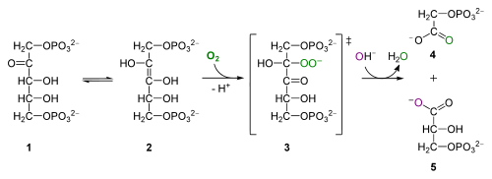
Why is carbon called the building block of life?
Carbon atoms
the basis of most molecules found in living things
Unique bonding properties

Slide 4
Monomers are small molecules that make up larger molecules called polymers.
Individual subunits
Ex: amino acids, fatty acids
Polymers(macromolecules.)are made of many monomers
Ex: proteins, lipids

Slide 5
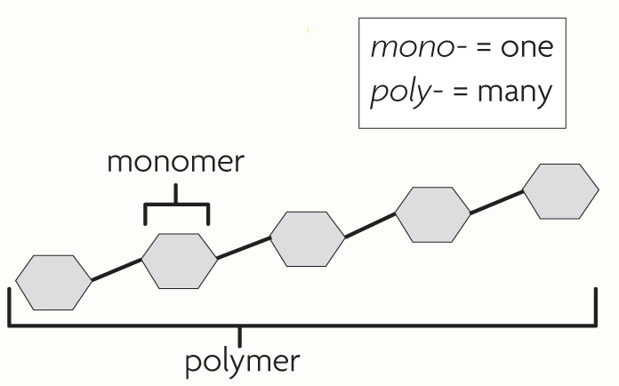

Slide 6
Four main types of Macromolecules
All organisms of made up :
1. Carbohydrates: Include sugars(glucose & fructose) & starches:
2. Lipids: Fats, oils, cholesterol
3.Proteins: There are 20 different amino acids—your body can make 12 of these.
meats, beans, & nuts
4.Nucleic acids: Function is to give instructions for making proteins
Two types: DNA & RNA

Slide 7
Monomers
Macromolecule | Monomer
Carbohydrate | Monosaccharide
Lipid | Fatty acid + glyercol
Protein | Amino acids
Nucleic Acids | Nucleotides

Slide 8
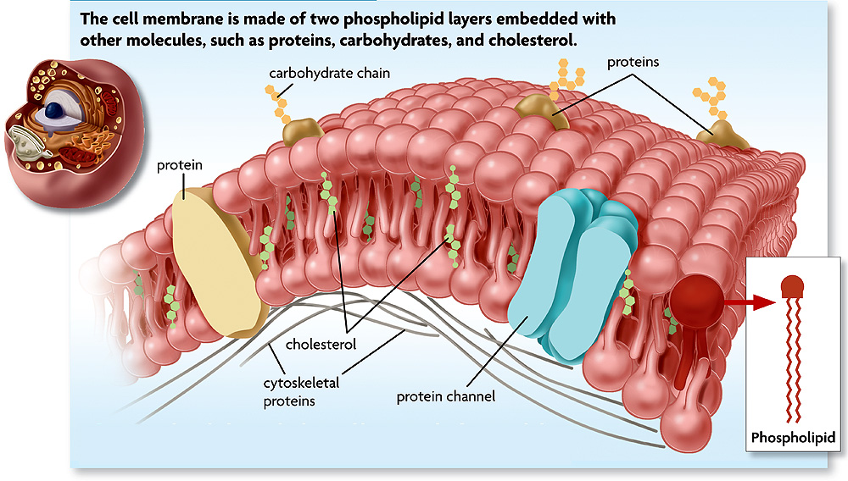
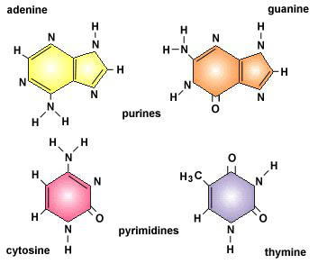
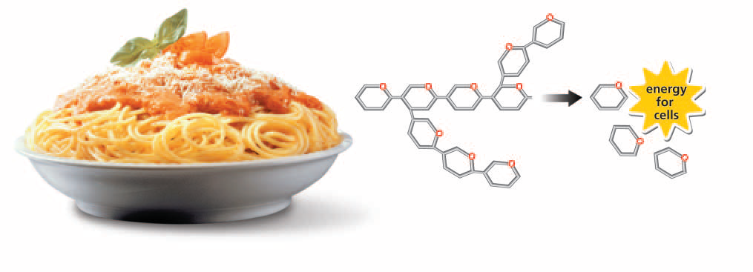
Protein
Protein
Lipids
Nucleic Acids
Carbohydrates

Slide 9
Chemical Reactions
Chemical reaction: process that changes one set of chemicals into another set of chemicals by breaking & forming chemical bonds
Contain reactants & products
Example:
6H2O + 6CO2 + light → C6H12O6 + 6O2

Slide 10
Reactants: chemicals that start a reaction
Products: chemicals that are made in a reaction
6H2O + 6CO2 + light → C6H12O6 + 6O2
Glucose
Reactants
Products

Slide 11
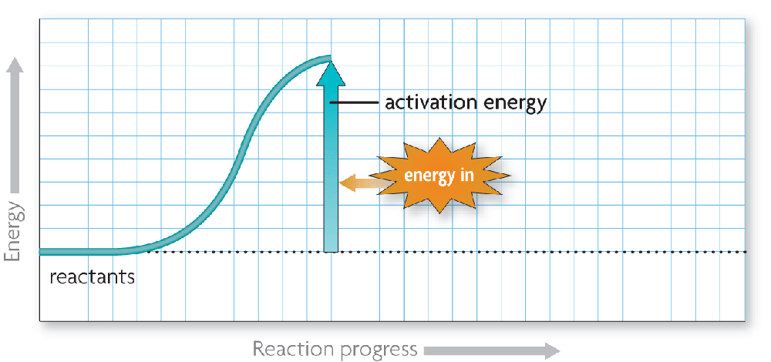
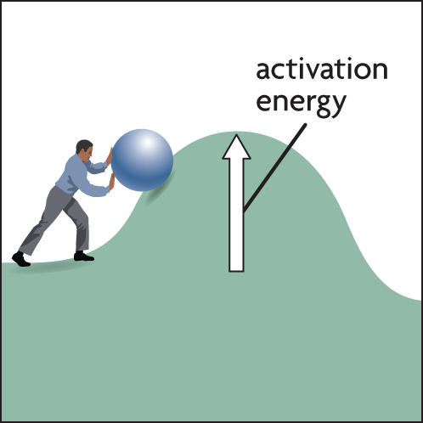
In order for a chemical reaction to take place, a certain amount of energy is needed to get it started.
Activation energy: amount of energy needed to start a reaction

Slide 12
Enzymes
Catalysts: any substance that speeds up a chemical reaction
Catalysts speed up reactions by lowering the amount of activation energy needed to start the reaction
Enzymes: biological catalysts that speed up reactions in living things
- Lower activation energy needed to
start reaction
- Increase reaction rate

Slide 13
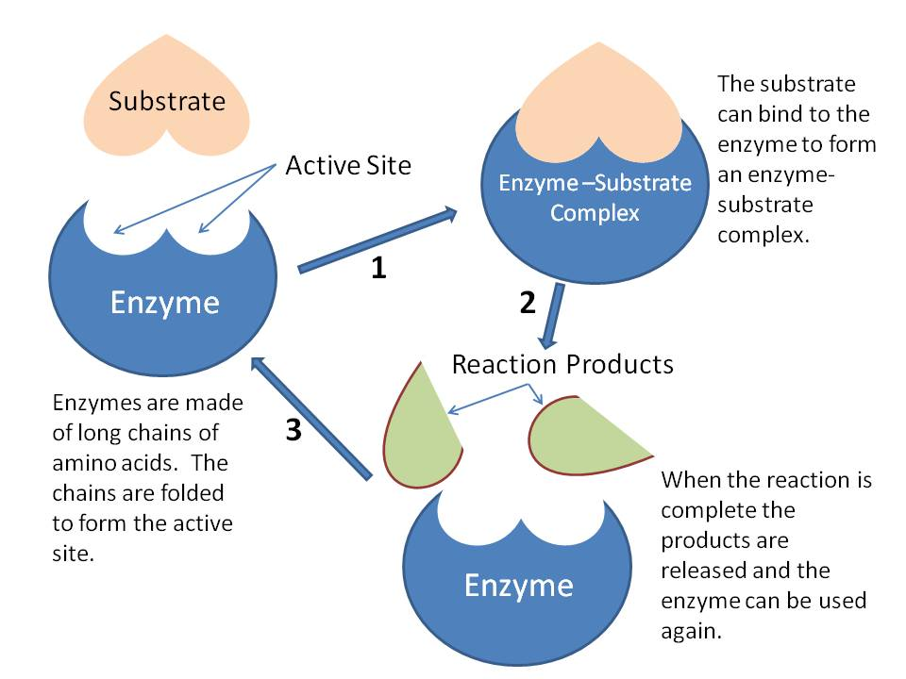
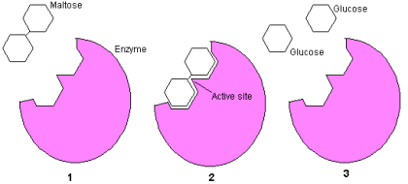
Most enzymes are proteins
Example: Lactase (-ase) means it’s an enzymes
An enzyme’s shape determines its function.
allows only certain reactants to bind with it

Slide 14
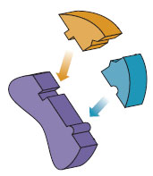
substrates (reactants)
Substrate: reactant that binds with an enzyme
An enzyme & a substrate fit together like a lock & key
Active site: specific place where substrate and enzyme bind
enzyme
Substrates bind to an enzyme at certain places called active sites.

Slide 15
Substrates bind to an enzyme at certain places called active sites.
The enzyme brings substrates together and weakens their bonds.
The catalyzed reaction forms a product that is released from the enzyme.

Slide 16
What things will affect enzyme activity?
Disruptions in homeostasis
Change in temperatures and pH levels
Changes in these conditions may affect the shape & function, or activity of an enzyme
Ex: When people run a temperature above normal, the hydrogen bonds in enzymes may be broken and it may lose its ability to function

Slide 17
1. In order for a molecule to be considered organic it must contain what?
Carbon

Slide 18
2. Fats, oils, and cholesterol are all examples of what macromolecule?
Lipids

Slide 19
3. What macromolecules are responsible for making proteins?
Nucleic Acids

Slide 20
4. Which kind of molecule provides building blocks for tissues, transport other molecules, and helps regulate certain reactions in the human body?
Lipids
Fats
Carbohydrates
Proteins

Slide 21
5. Pasta & bread are examples of foods that contain a large amount of what macromolecule?
Carbohydrates

Slide 22
6. What are the building blocks of proteins?
Amino Acids

Slide 23
7. What type of lipids make up the cell membrane?
Phospholipids

Slide 24
8. DNA & RNA are examples of what macromolecule?
Nucleic Acids

Slide 25
9. The process that changes one set of chemicals into another set by breaking and chemical bonds is know as what?
Chemical Reaction

Slide 26
10. What is the name for the chemicals that start a reaction?
Reactants

Slide 27
11. What are the products in the chemical reaction? 2H2 + O2 → 2H2O

Slide 28
12. Any substance that speeds up a chemical reaction is known as what?
Catalyst

Slide 29
13. How do enzymes speed up biochemical reactions?
They provide energy to the reactants.
They absorb energy from the products.
They lower the activation energy of the reaction.
They increase the number of available reactants particles.

Slide 30
14. What are enzymes made of?
Proteins

Slide 31
15. The reactants an enzyme binds with in a chemical reaction are known as what?
Substrates

Slide 32
16. The place where an enzyme and a substrate bind together is known as what?
Active Site

Slide 33
17. What is the job of an enzyme?
To speed up reactions

Slide 34
18. After an enzyme is finished producing a product in a chemical reaction, what happens to the enzyme?
It will die because enzymes can only make one product.
It will stop working because its shape was changed during the reaction.
It will find more substrates to make more products.
It will leave the chemical reaction since it is no longer needed.

Slide 35
19. The maintenance of constant internal conditions is known as what?
Homeostasis

Slide 36
20. A molecule of DNA is a polymer composed of a. glucose b. amino acids c. fatty acids d. nucleotides

Slide 37
21. Which is an organic compound found in most cells? a. glucose b. water c. sodium chloride d. oxygen gas

Slide 38
22. Which pair of compounds can be classified as inorganic? a. nucleic acids and minerals b. proteins and water c. water and salts d. nucleic acids and proteins

Slide 39
23. Most cell membranes are composed principally of a. DNA and ATP b. proteins and lipids c. chitin and starch d. nucleotides and amino acids

Slide 40
24. Which molecules have a primary function of providing a rapidly available energy source for living things?
Proteins
Carbohydrates
Fats
Amino Acids

Slide 41
25. Match the macromolecules with its building blocks.
Carbohydrate
Nucleotides
Lipids
Amino Acids
Proteins
Monosaccharide
Nucleic Acids
Fatty acid + glyercol

