Slide 1
Cell Structure and Functions Ch. 3.1 & 3.2

Slide 2
Question
What is the smallest unit of life?

Slide 3
Answer
Cells

Slide 4
Question
Describe the two places in the cell where ribosomes may be found.

Slide 5
Answer
Rough ER
Cytoplasm

Slide 6
Question
What organelle is responsible for producing the lipids that make up the cell membrane?

Slide 7
Answer
Smooth ER

Slide 8
Question
What structure in the cell is responsible for making ribosomes?

Slide 9
Answer
Nucleolus

Slide 10
Question
Describe the path proteins would follow as they leave the cell.

Slide 11
Answer
Ribosomes, Rough ER, Golgi Apparatus

Slide 12
Question
What are the most numerous parts in the cell?

Slide 13
Answer
Ribosomes

Slide 14
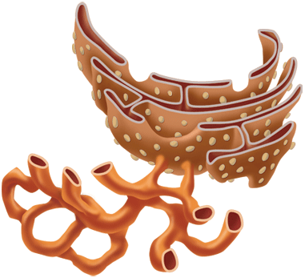
Question
Name the two organelles?

Slide 15
Answer
Smooth and Rough ER

Slide 16
Question
Which two organelles in plant cells are responsible for providing energy for the cell?

Slide 17
Answer
Chloroplast
Mitochondria

Slide 18
Question
From the scientists below, who discovered cells by looking at corks found in oak trees?

Slide 19
Answer
Hooke

Slide 20
Question
The cell membrane is made up of a bilayer of ___________________.

Slide 21
Answer
phospholipids

Slide 22
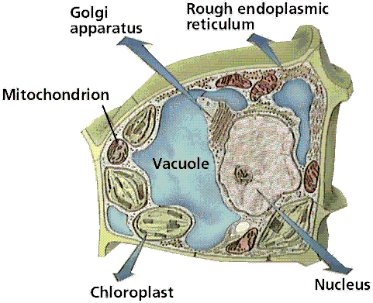
Question
Animals or Plant cell?

Slide 23
Answer
Plant

Slide 24
Question
What are organelles?

Slide 25
Answer
Specialized structures inside the cell that that perform important cellular function.

Slide 26
Question
What structure is larger in plant cells than it is in animal cells?

Slide 27
Answer
Vacuole (Central Vacuole)

Slide 28
Question
State 1 of the 3 parts of the cell theory;

Slide 29
Answer
All organisms are made of one or more cells.
The cell is the most basic unit of life.
All existing cells are produced by other living cells.

Slide 30
Question
What is an example of a prokaryote cell?

Slide 31
Answer
Bacteria cell

Slide 32
Question
What two things are found in eukaryotic cells that are not found in prokaryotic cells?

Slide 33
Answer
Nucleus
Membrane-bound Organelles

Slide 34
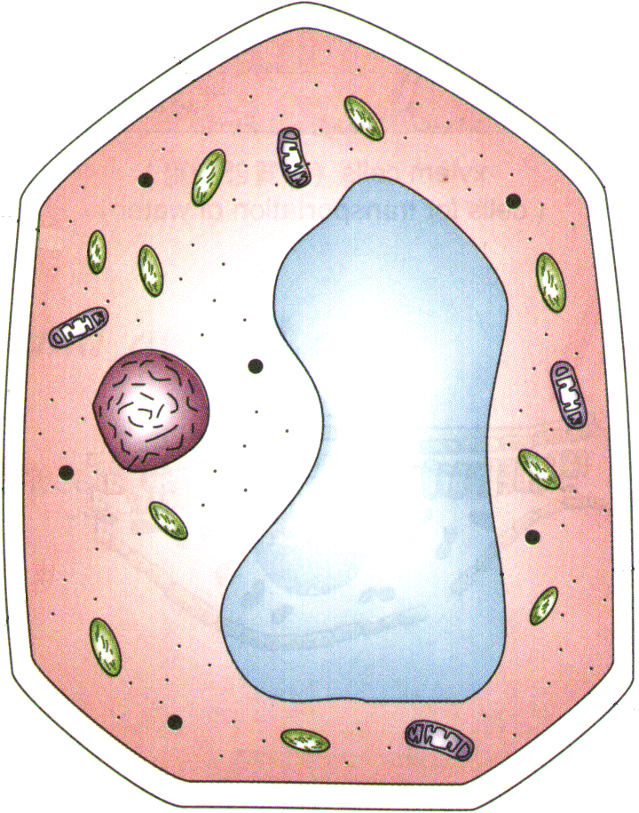
Question
What part of the cell is the arrow pointing to?

Slide 35
Answer
Cytoplasm

Slide 36
Question
What two things make up the cytoskeleton?

Slide 37
Answer
Microtubules
Microfilaments

Slide 38
Question
What is the purpose of cilia and flagella?

Slide 39
Answer
Helps cells move

Slide 40
Question
What is the function of chromatin?

Slide 41
Answer
Contain DNA that make up chromosomes

Slide 42
Question
How would proteins transported by the ER get to the Golgi?

Slide 43
Answer
Vesicles that pinch off the ER, transports the proteins to the Goli.

Slide 44
Question
How are worn out parts of cells removed from the cell?

Slide 45
Answer
Lysosomes

Slide 46
Question
You won’t find a cell wall in which of these kinds of organism?
A. plants
B. Animals
C. bacteria
D. None of the above

Slide 47
Answer
B. animals

Slide 48
Question
What organelle is responsible for making food through photosynthesis?

Slide 49
Answer
Chloroplast

Slide 50
Question
What is selective permeability?

Slide 51
Answer
Ability to let small things in and out the cell membrane

Slide 52
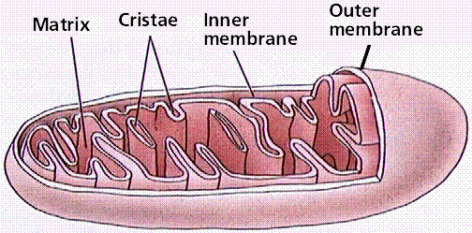
Question
What organelle is this?

Slide 53
Answer
Mitochondria

Slide 54
Question
What organelle is called the highway of the cell?

Slide 55
Answer
ER

Slide 56
Question
What is the job of the ribosomes?

Slide 57
Answer
To synthesize proteins

Slide 58
Question
From the list below, who states that cells come from preexisting cells?

Slide 59
Answer
Virchow

Slide 60
Question
How are bacteria different from animals cells?

Slide 61
Answer
Bacteria cells are prokaryote
Animals cells are eukaryotes

Slide 62
Question
Which organelle is called the post office of the cell? Why?

Slide 63
Answer
Golgi Apparatus because it packages and ships material throughout the cell.

Slide 64
Question
True or False
A cell wall is found in plant cells.

Slide 65
Answer
True

Slide 66
Question
The structure that regulates what goes in and out the cell is called the ___________.

Slide 67
Answer
Cell membrane

Slide 68
Question
From the list below, who states that all all organisms are made up of cells?

Slide 69
Answer
Shwann and Shleiden

Slide 70
Question

